Slide 1
Generative Models

Slide 2
Links to have open
GANSpace
GAN Lab
GANpaint
https://j.mp/cam2head

Slide 3
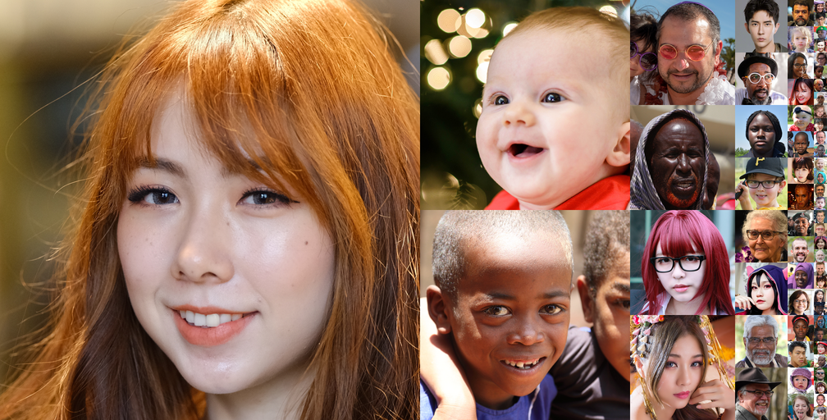
What’s the difference?

Slide 4
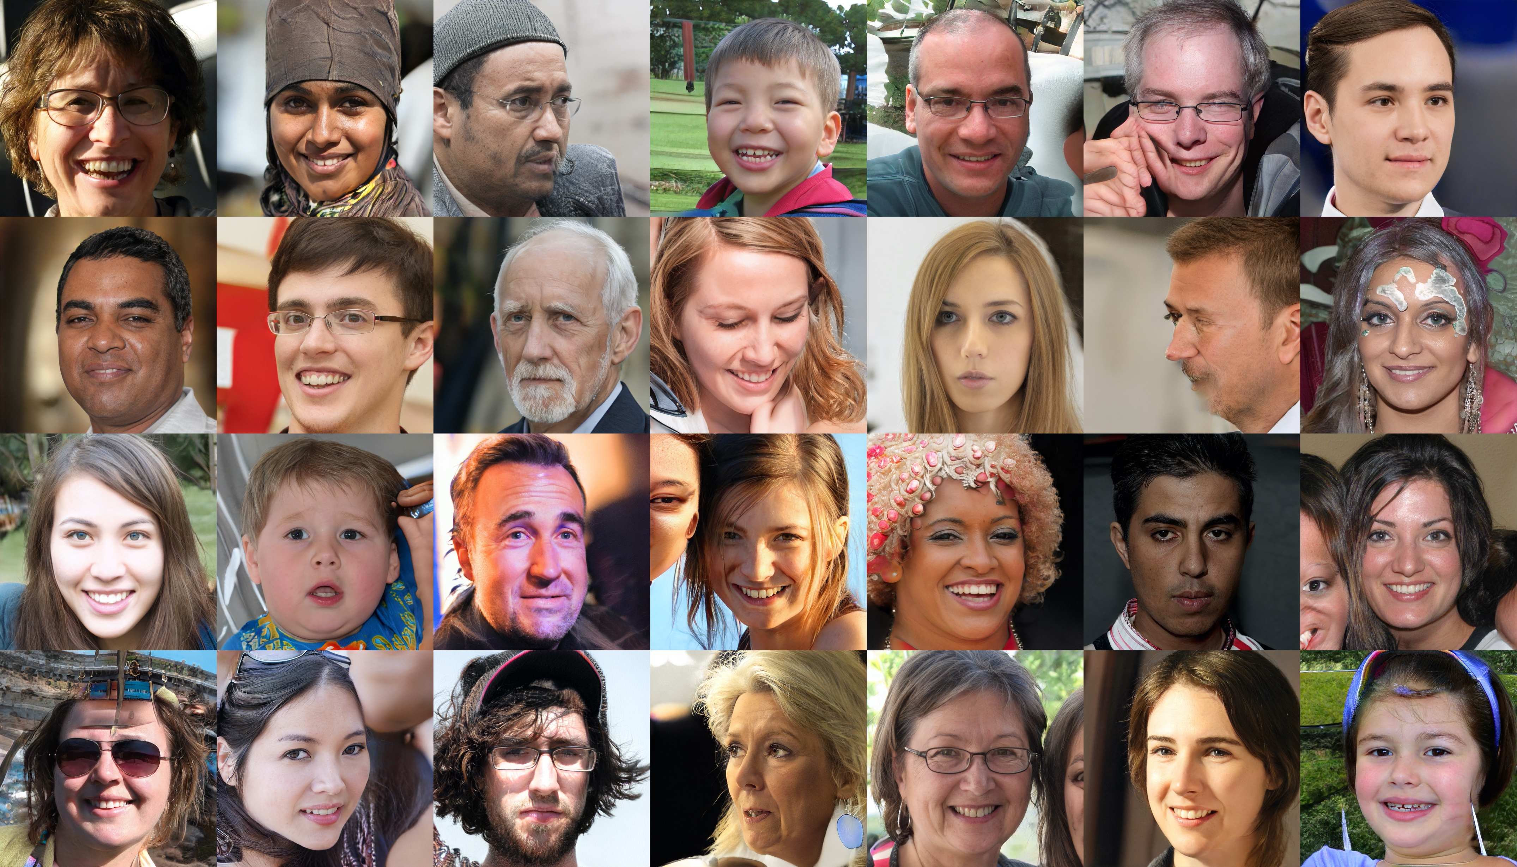

Slide 5
Which was real?
First slide: FFHQ dataset (https://github.com/NVlabs/ffhq-dataset)
Second slide: mid-training snapshot of fine-tuning StyleGAN2

Slide 6
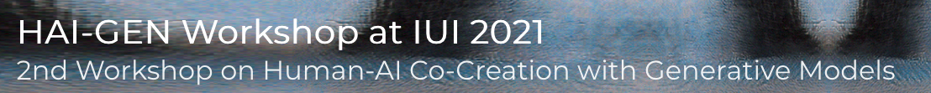
Today: Generation
One approach: LMs.
Today: alternatives
Applications examples: HAI-GEN workshop
Platform game level generation
3D animal shapes
Controlling an instrument with your voice g.co/tonetransfer
Generating documentation for Jupyter notebooks

Slide 7
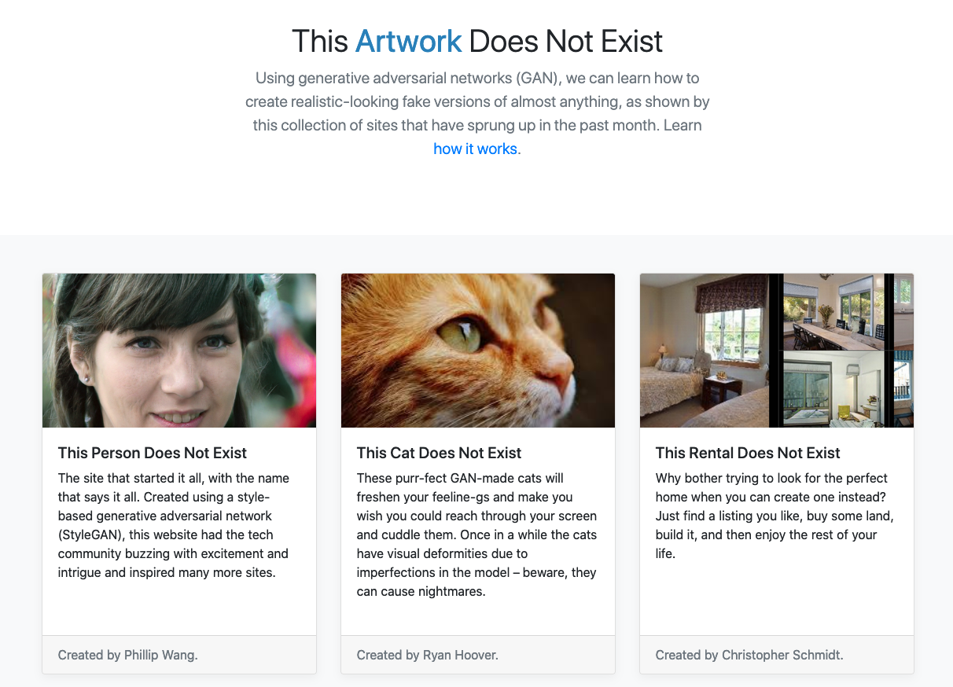
https://thisxdoesnotexist.com/

Slide 8
How might an AI generate an image?

Slide 9
Goal: Why can generative models work?
For details on how, see the readings for this week
What about the world makes this work?

Slide 10
Main Ideas Today
Real things occupy a tiny portion of the space of all possible things.
Images, sentences, sounds, etc.
We can describe that tiny space as a distribution
We can compose learned functions in various ways to model that distribution

Slide 11
Real things occupy a tiny portion of the space of all possible things.
Natural images are a small subset of all possible images

Slide 12
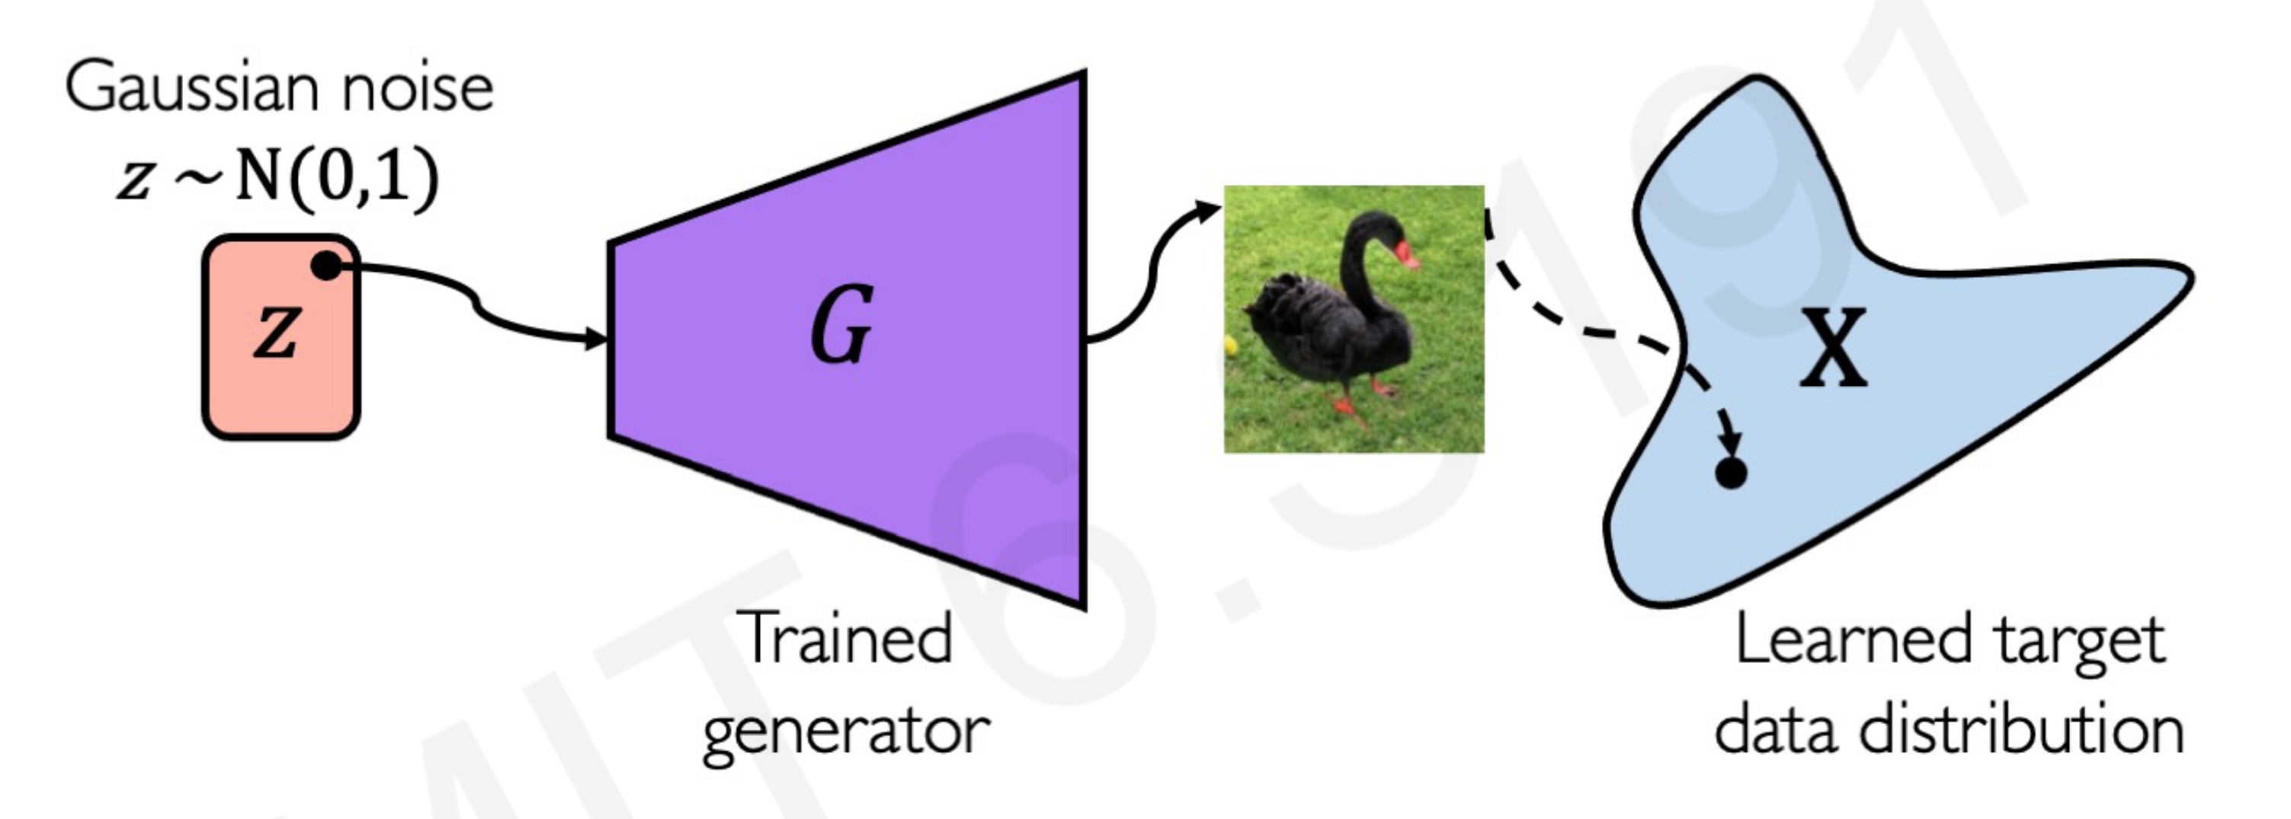
Generator Network
Demo: https://observablehq.com/@stwind/latent-flowers-ganden
http://introtodeeplearning.com/slides/6S191_MIT_DeepLearning_L4.pdf

Slide 13
How to compose functions to model distributions?
And how do we train those functions??

Slide 14
Ways of modeling distributions
Single decisions (softmax classifier)
Sequential decisions (autoregressive)
Latent variables
Diffusion-based

Slide 15
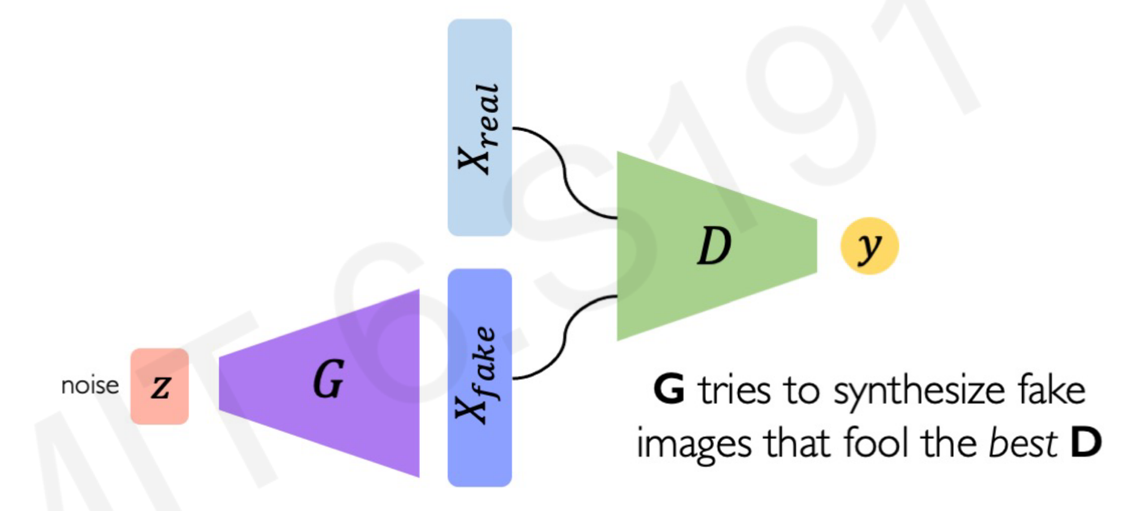
Generative Adversarial Network
Try it at GANLab

Slide 16
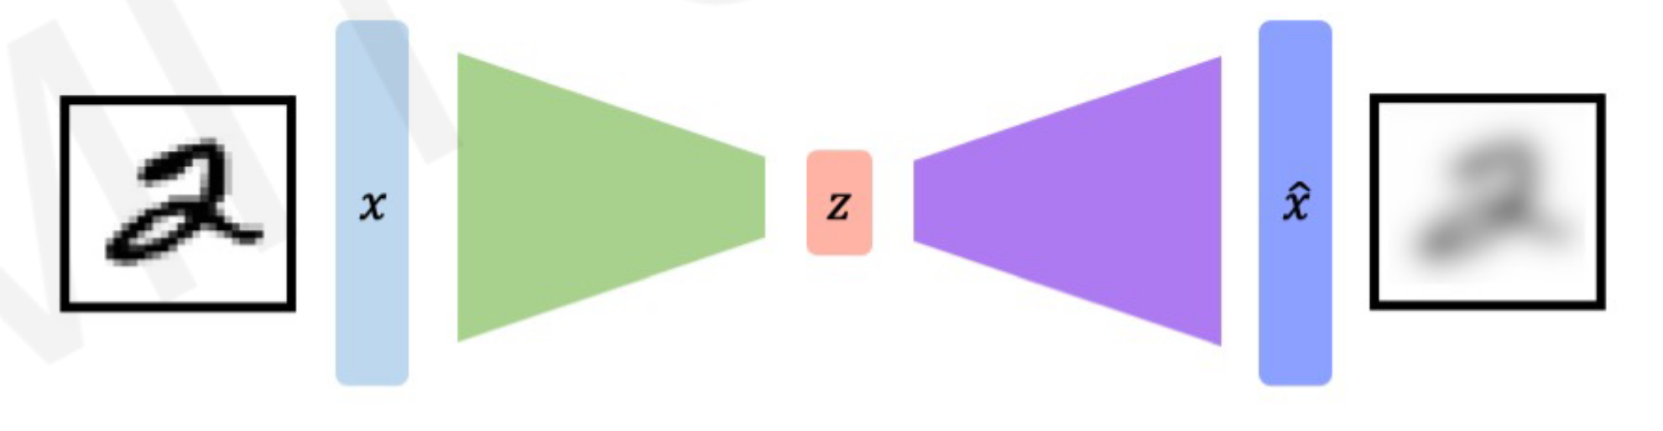
Autoencoder
Reconstruction Loss: output minus input
Encoder E
Decoder D
http://introtodeeplearning.com/slides/6S191_MIT_DeepLearning_L4.pdf

Slide 17
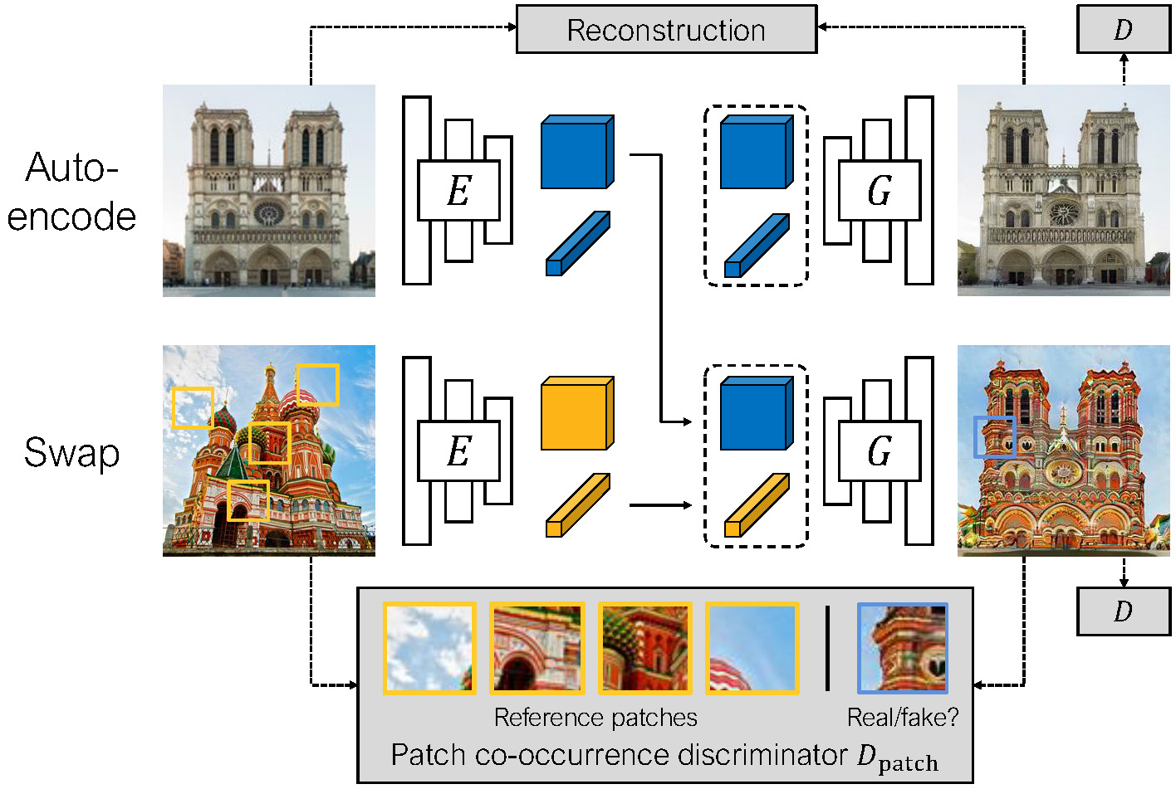
Swapping Autoencoder
https://taesung.me/SwappingAutoencoder/

Slide 18
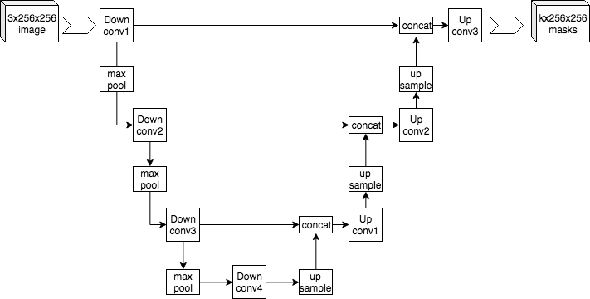
U-Net
https://commons.wikimedia.org/wiki/File:Example_architecture_of_U-Net_for_producing_k_256-by-256_image_masks_for_a_256-by-256_RGB_image.png

Slide 19
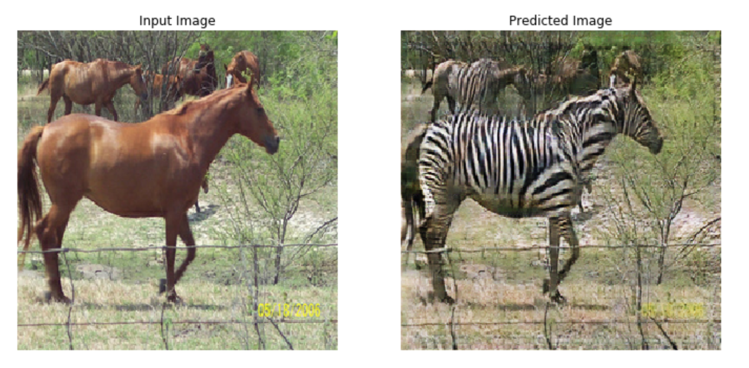
CycleGAN (image <-> image)
https://www.tensorflow.org/tutorials/generative/cyclegan

Slide 20
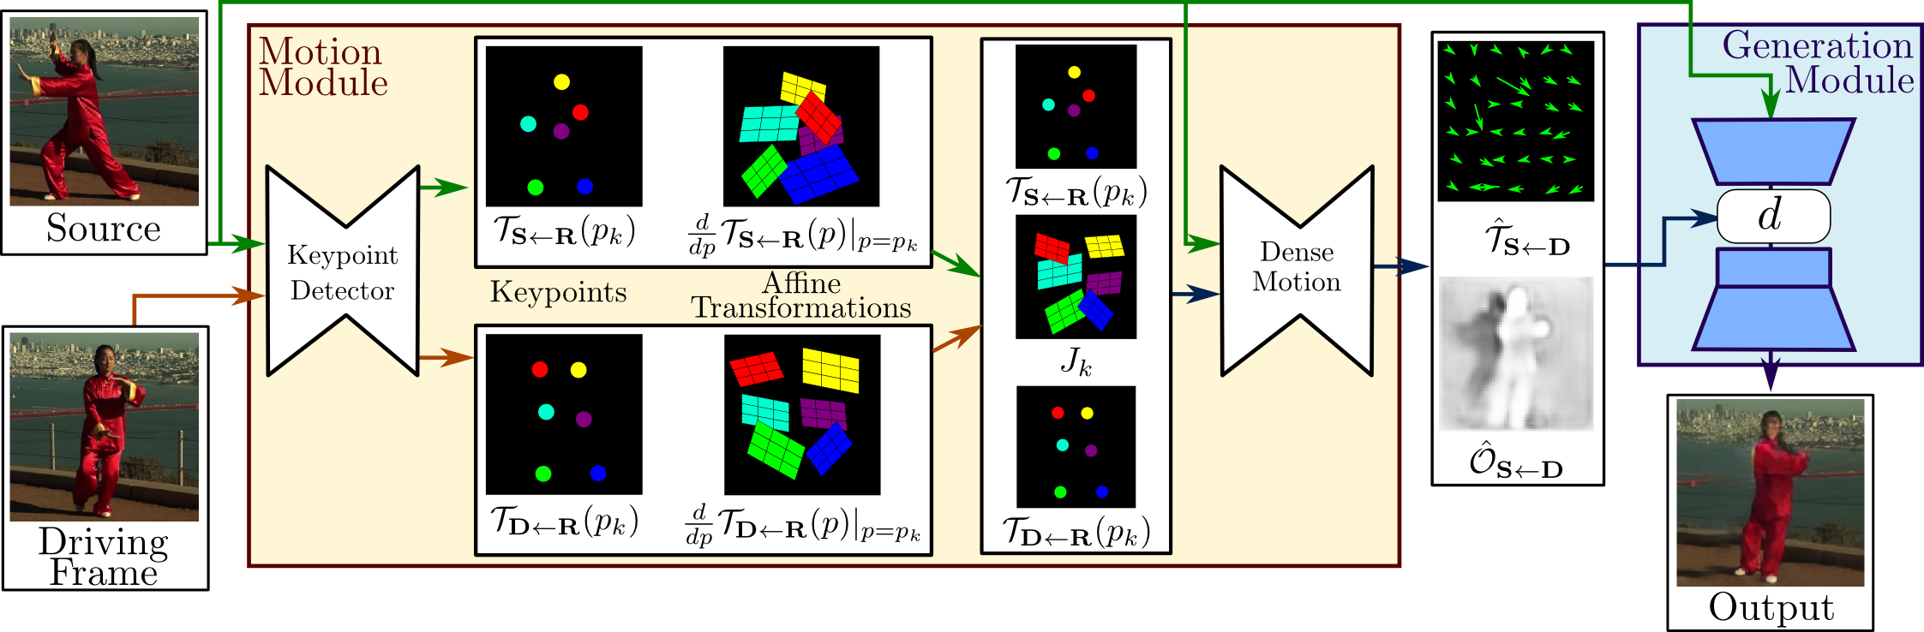
You don’t need all this for a simple deepfake
https://aliaksandrsiarohin.github.io/first-order-model-website/
Demo: https://github.com/eyaler/avatars4all

Slide 21
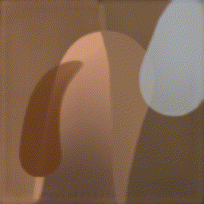
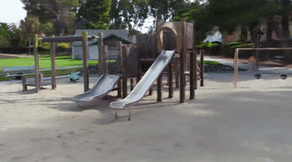
Many other creative approaches
Learning to draw an image stroke-by-stroke
PaintBot / https://arxiv.org/abs/1904.02201
Model-based RL: https://arxiv.org/abs/1903.04411
Interactive image editing (GANPaint)
Controls (e.g., GANSpace)
Use a sequence model (Transformers)
https://compvis.github.io/taming-transformers/
Neural Rendering (NeRF)
https://github.com/Kai-46/nerfplusplus
https://github.com/yenchenlin/awesome-NeRF

Slide 22
Applications
Video conferencing
Background segmentation (e.g., virtual backgrounds)
regenerate the face on the client side (e.g., NVIDIA Maxine)
Sim2real: train robots in simulations that perform well in real world
Super-resolution, image/sound restoration
Inpainting: remove distracting objects (now in Photoshop)
Anomaly detection (e.g., tumor detection)
Causal inference

Slide 23
Practical tips
Use pre-trained models
Use battle-tested codeStart with already-running code and tweak it
Consider other approaches besides GANs:
VAEs like https://github.com/openai/dall-e or Taming Transformers
https://github.com/lucidrains/DALLE-pytorch
CPPNs

Slide 24
Perspectives and Ethical Considerations

Slide 25
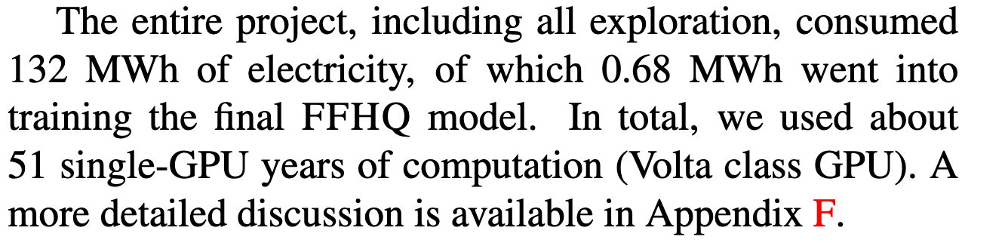
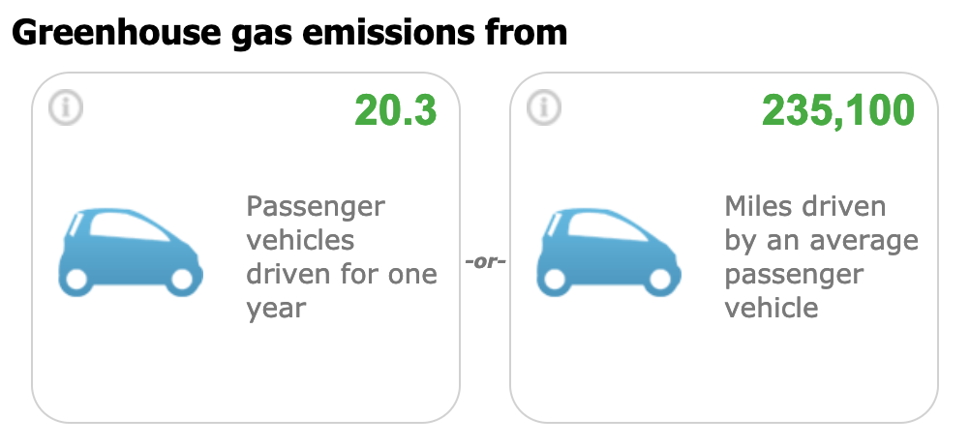
StyleGAN2’s Energy Cost
https://arxiv.org/abs/1912.04958
https://www.epa.gov/energy/greenhouse-gas-equivalencies-calculator

Slide 26
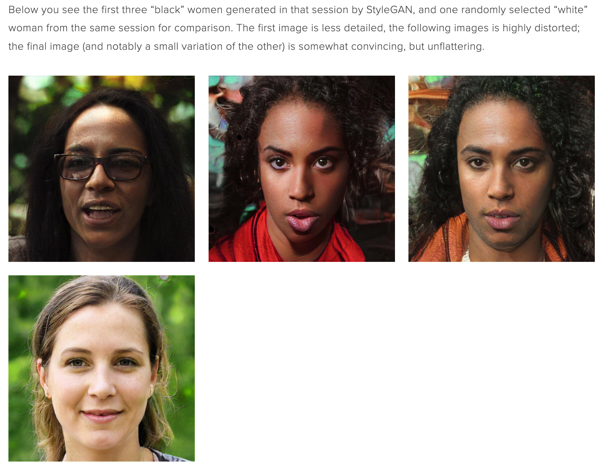
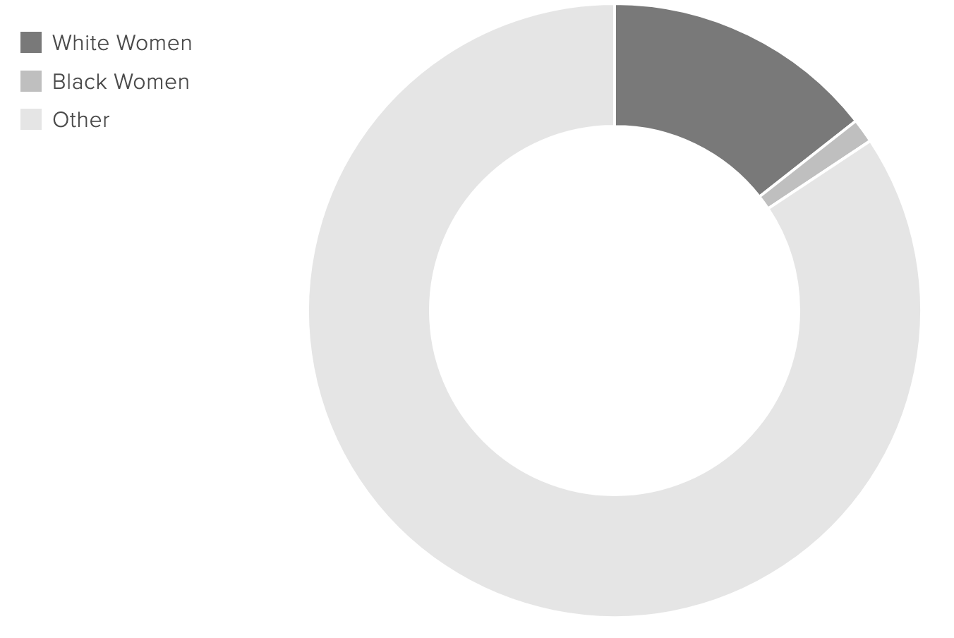
https://www.intersectsy.com/intersectsy/2019/10/3/what-i-learned-about-bias-from-the-first-ai-generated-faces-on-wikimedia-commons

Slide 27
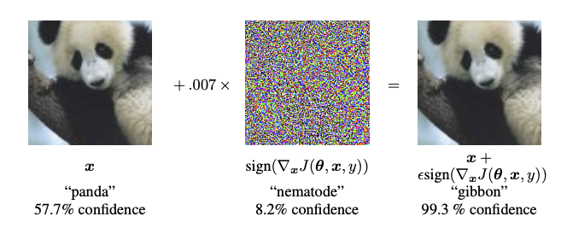
Adversarial Examples
Generating an image to fool a classifier
https://www.tensorflow.org/tutorials/generative/adversarial_fgsm

Slide 28
Who owns the image? Who owns the model?

Slide 29
Other questions?

